Slide 1

AI & PARKINSON’S DISEASE (PD)
A MIT’s project from Dina Katabi and Nicole Pham, Professors in the Department of Electrical Engineering and Computer Science.
Presented by Nina Vavrinovits Kalampogia

Slide 2

AI
Mimics human-like thinking
Analyzes data
Finds patterns
Makes predictions & recommendations

Slide 3
PD
Shaking, stiffness, difficulty balancing
Loss of brain cells produces reduced level of dopamine
World’s fastest growing neurological disease
Over 10 million people have PD worldwide

Slide 4
There is relationship between Parkinson’s and breathing

Slide 5
Device
A small device placed in patient’s bedroom while sleeping
Function
It emits radio signals and analyzes the reflections created by the surrounding environment, including breathing patterns
AI’s role
AI-based model processes signals by a neural network, which uses algorithms to transform data into useful information

Slide 6
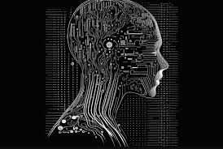
TEST:
Included data from 11,964 nights of sleep with more than 120,000 hours of nighttime breathing among 757 people with PD and 6,914 without PD.
RESULT:
AI system can:
Predict the presence or development of PD with 90% accuracy
Track PD progression and estimate PD severity as well as the MDS-UPDRS*
Provide an objective, non-invasive, at-home assessment of PD while a person is asleep, without touching the body
Combine measurements from multiple nights to achieve optimal test accuracy
Provide nightly and weekly measurements in a person’s home, that tests such as the MDS-UPDRS* would not be able to capture
*MDS-UPDRS (PD rating scale used by doctors)

Slide 7
THANK YOU

